Slide 1

SPotify analysis
By: Prianka Kibria

Slide 2
Getting to know the data:
The data has been extracted from Kaggle. This particular data is the Top 200 Weekly Global charts on Spotify. It contains songs that have been played most frequently and have been able to reach the top 200. Please note for this particular analysis I will only be focusing on the top 10 songs.
Dataset Reference: https://www.kaggle.com/datasets/sashankpillai/spotify-top-200-charts-20202021/code

Slide 3
Spotify Streams
Now that we are currently in a digital era music recording and sharing companies no longer rely on the purchasing of CD’s, albums and concerts. We can all have that in the palm of our hands now through our devices. Especially with Spotify where you have access not only to high end popular main stream artists music, but also up and coming ones. One of the best approaches in being able to run a successful streaming service is to get to know the customers. Using this approach can be a great tactic in boosting your customer experience, enhance aglorithims, target audiences and use it for future business approaches. I find this beneficial since it adopts a data driven tactic in comprehending the music taste of the listeners and possibly create ever lasting customers as well as bring in new uses.
Today I will be using Kaggles Top 200 Weekly Global charts to analyze on key components that can contribute to Spotify and perhaps increase their business acumen over all and provide recommendations to business stakeholders on what can be done to contribute to such.

Slide 4
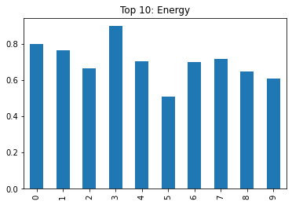
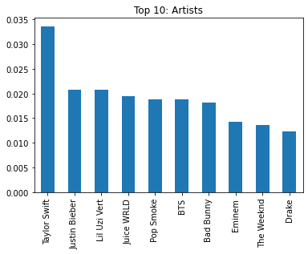
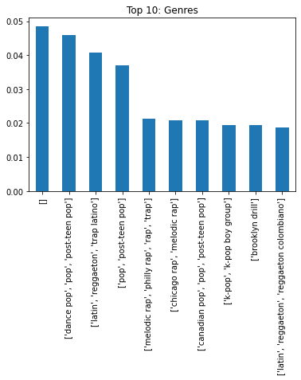
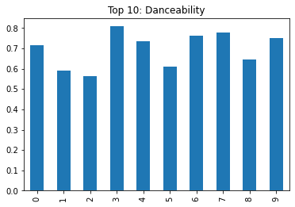
Contributing factors Towards Streaming

Slide 5
Interpreting my results:
My final model evaluation had the following scores:
Training accuracy: 97%
Testing accuracy: 87%
My training results indicate that there may be a small limitation of over-fitting data on my model. This can possibly mean that the data may be generated from its data being repeated and the data might have to be changed or updated.
My testing results using the rule of thumb of over 60% performed well based on the data that was used towards streams. Indicating that the current data, works well but can be improved with other contributing factors.

Slide 6
Findings:
Streams are interdependent on characteristics such as who the artist is as well as musical characteristics such as danceability, genre, and energy.
Using these findings we can make a much more personable experience for the users.
Based on the likeability and contributing factors we can target audiences with partnerships in ads.

Slide 7
Recommendations:
Characteristics and personalization can be used to optimize and increase streaming
Based on this data it can also provide insight on improvements that can be made on the platform
Promoting artists, genres, with the characteristics mentioned can also improve engagement of using Spotify
Continuously update the weekly charts to provide suggestions to users

